Slide 1
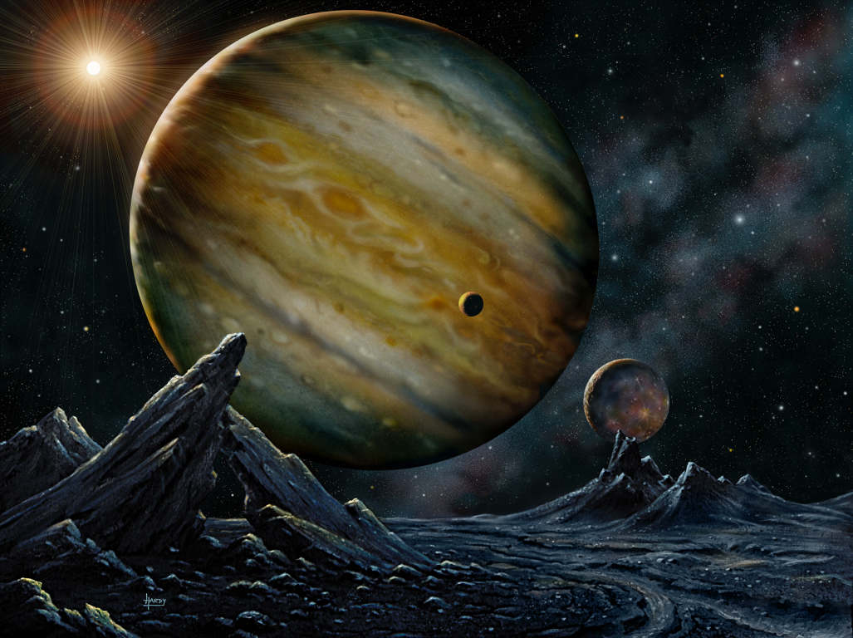
EXTRASOLAR PLANETS

Slide 2
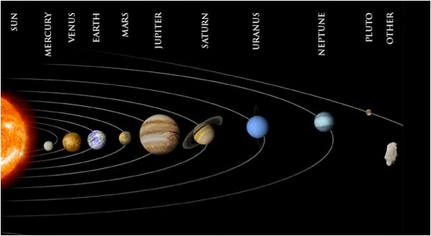
THE SOLAR SYSTEM

Slide 3
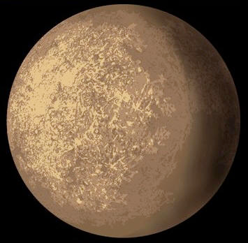
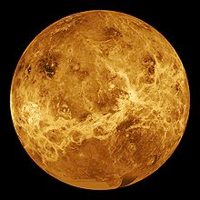
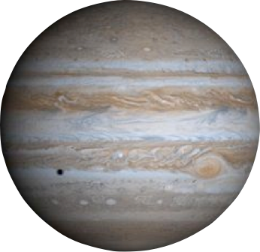
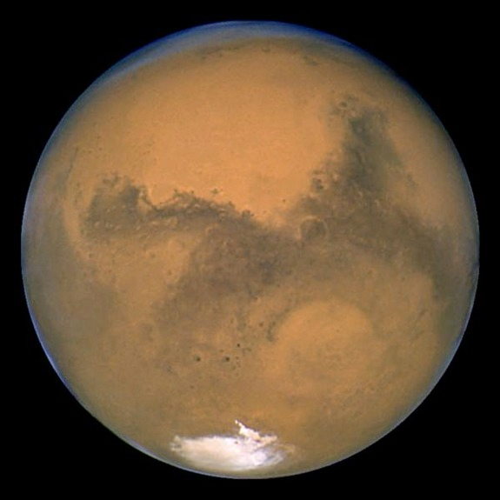
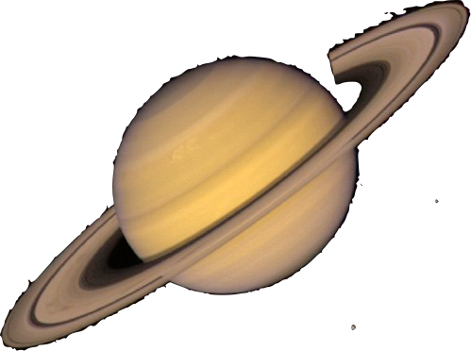

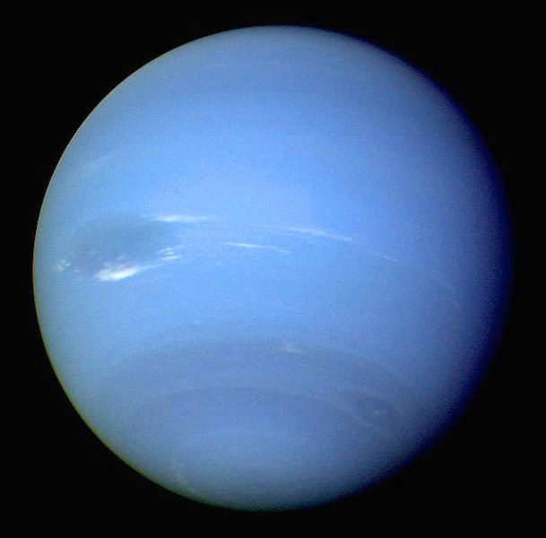
Mercury
Earth
Venus
Mars
Jupiter
Saturn
Uranus
Neptune

Slide 4
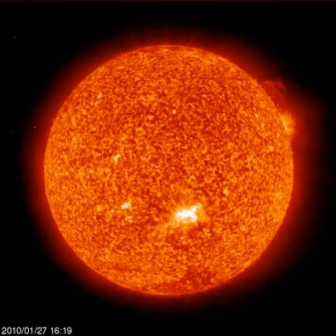
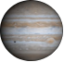
Jupiter
Earth
THE SUN

Slide 5
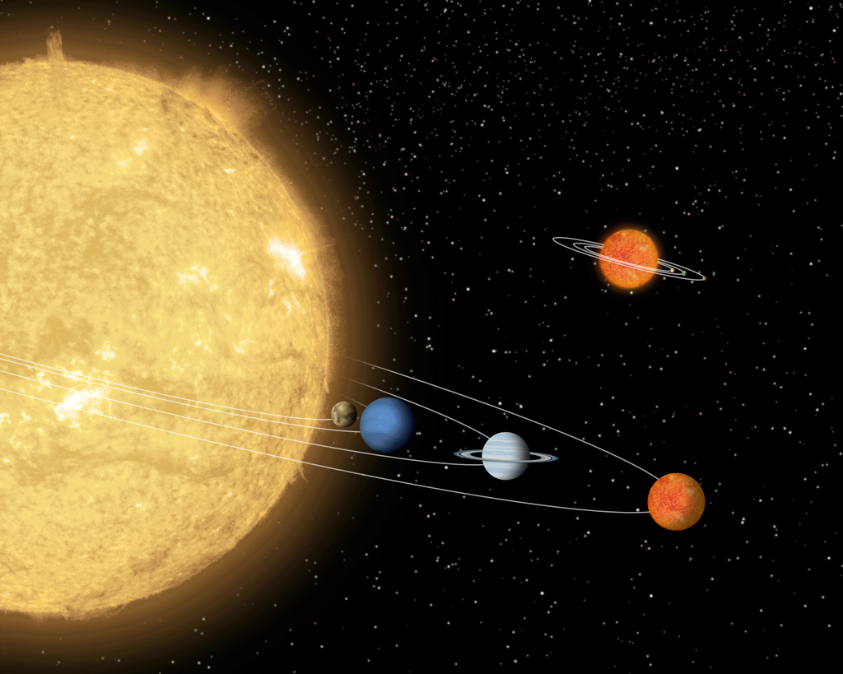
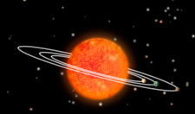
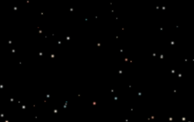

Slide 7
Alfa Centauri
Earth
Exoplanets!
Solar System

Slide 8
Exoplanets are planets outside the solar system

Slide 10
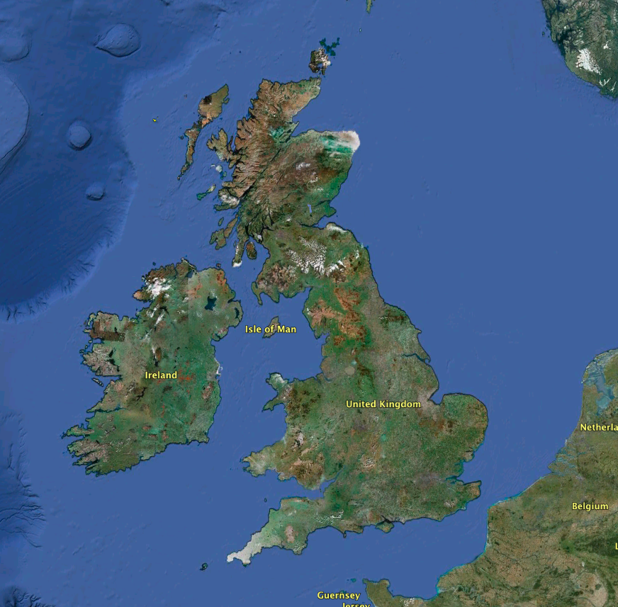
Neptune
Earth
Sun
Jupiter

Slide 11
Image: NASA

Slide 12
How can we see them?

Slide 13
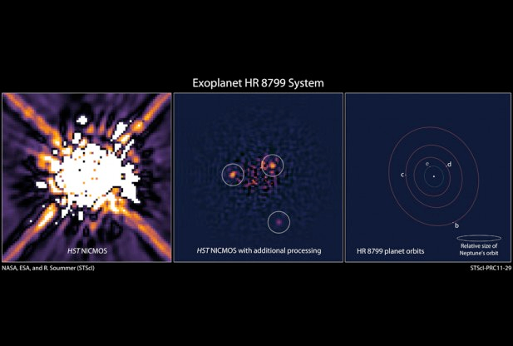
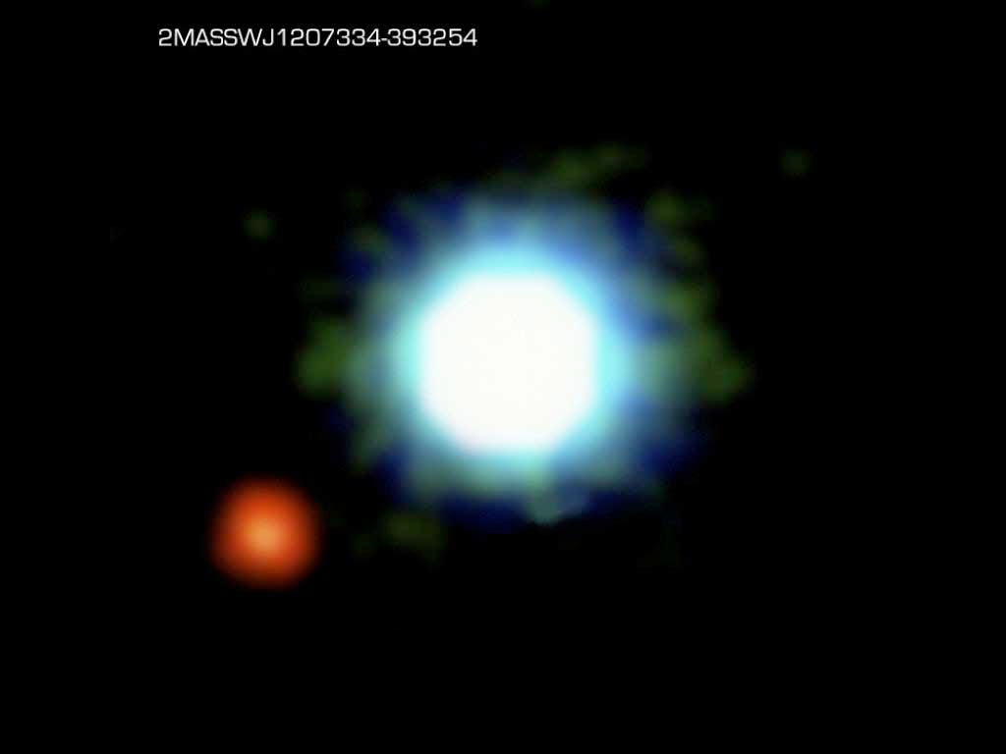
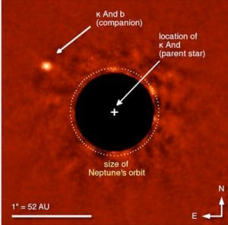
Direct Imaging

Slide 14
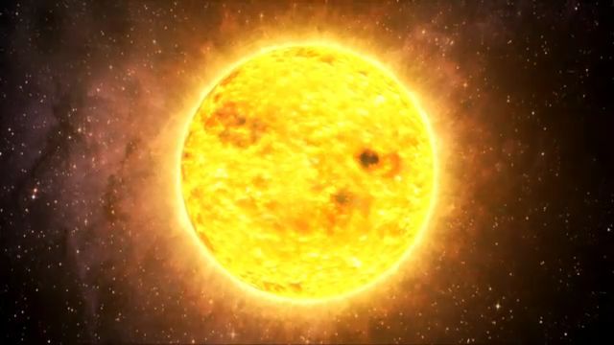
Transit method

Slide 15
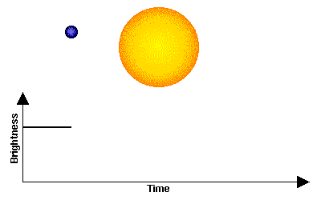
Transit method

Slide 16
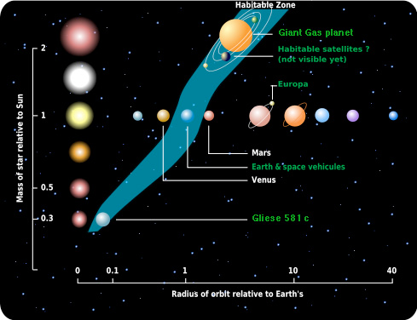
Habitable Zone

Slide 17
Ground based surveys
HAT NETWORK
Arizona
Hawaii

Slide 18
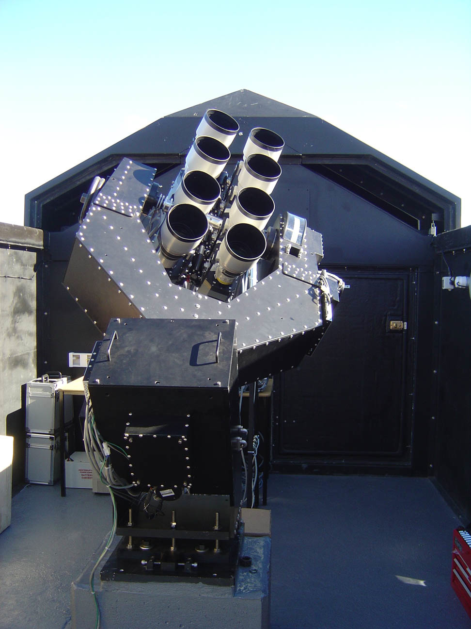
Ground based surveys
Super WASP
La Palma, Spain
South African Astronomical Observatory

Slide 19
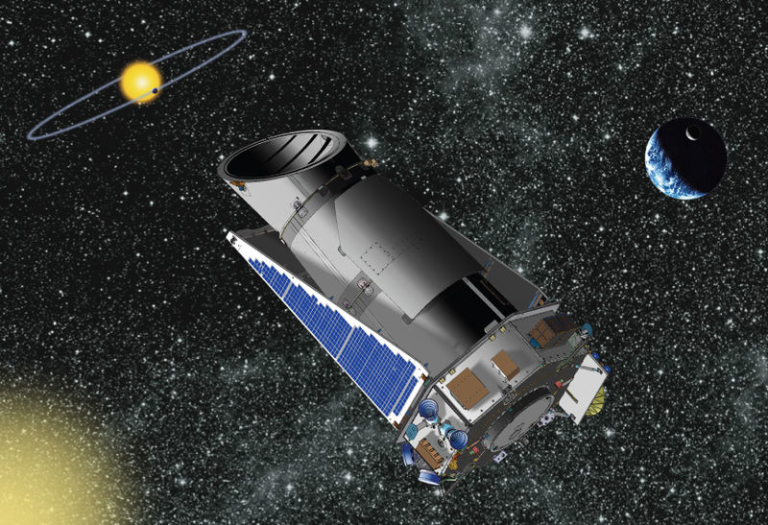
Space missions
Kepler
Launched in March 2009 - 2326 planets candidates

Slide 20
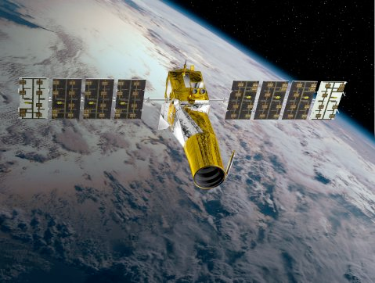
Space missions
COROT
Launched in December 2006 - 24 confirmed planets

Slide 21
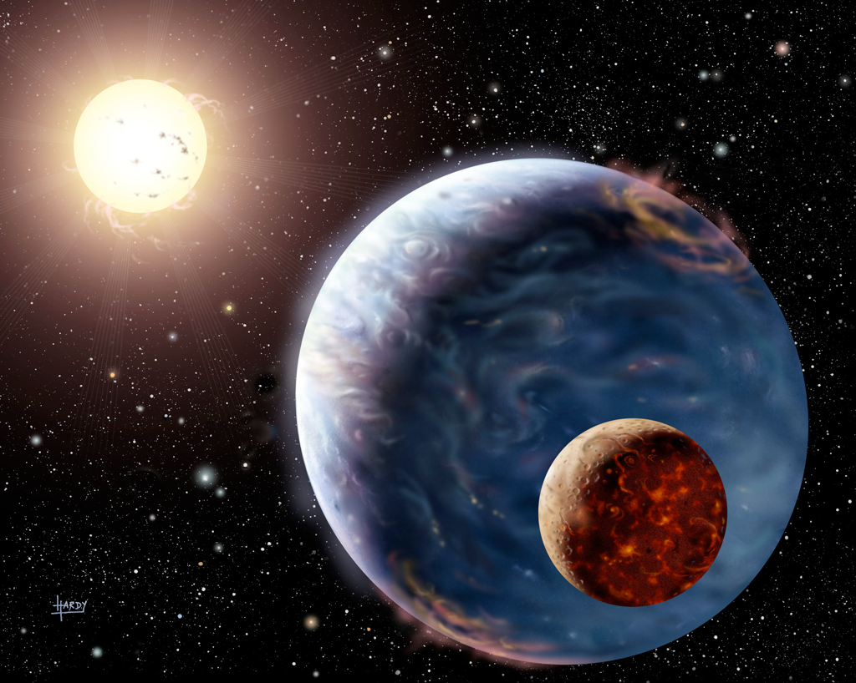
END

